Slide 1
chapter 9
CS 3370 – C++
Containers

Slide 2
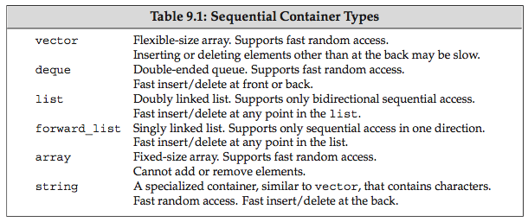
Sequential Containers
array and forward_list are new in C++11.
All are expandable except array.

Slide 3
std::array
A “wrapper” around built-in arrays
a “first-class” object with value semantics
they don’t decay to pointers
passed by value to functions (i.e., copied)
arrays of same size can be assigned, compared
Provides:
iterators (begin, end, random-access operations)
compatibility with range-for loops
size( ) method
index range checking (with at( ))
automatic zero-initialization
Defined in <array>

Slide 4
enum {N = 5};
array<int, N> a = {1,2,3,4};
cout << sizeof(a) << endl; // 20
cout << a.size() << endl; // 5
for (auto x: a)
cout << x << ' '; // 1 2 3 4 0
cout << endl;
array<int, N> b;
b = a;
assert(b == a);
b[4] = 5;
assert(b != a);
for (auto x: b)
cout << x << ' '; // 1 2 3 4 5
cout << endl;

Slide 5
Dynamic Input with vector
// Shows how to easily read/print ints from a file
#include <algorithm>
#include <fstream>
#include <iostream>
#include <iterator>
#include <vector>
using namespace std;
int main() {
ifstream f("ints.dat");
auto b = istream_iterator<int>(f),
e = istream_iterator<int>();
vector<int> v(b,e);
copy(v.begin(), v.end(),
ostream_iterator<int>(cout, " "));
cout << endl;
}
Notes:
You don’t need the vector!

Slide 6
Dynamic Sequences without vector
// Shows how to easily read/print ints from a file
#include <algorithm>
#include <fstream>
#include <iostream>
#include <iterator>
using namespace std;
int main() {
ifstream f("ints.dat");
auto b = istream_iterator<int>(f),
e = istream_iterator<int>();
copy(b,e,ostream_iterator<int>(cout, " "));
cout << endl;
}
Notes:
You don’t need the vector!

Slide 7
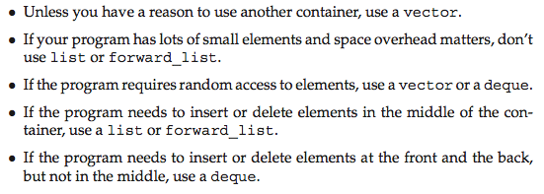
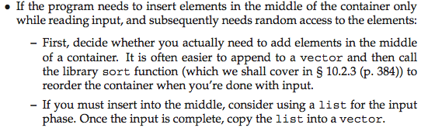
Guidelines for Expandable Containers

Slide 8
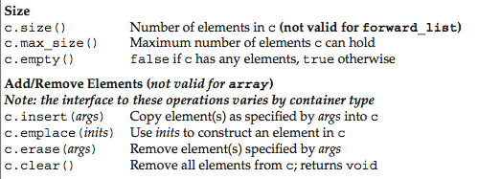
Common Container Operations

Slide 9
emplace_back vs. push_back
push_back requires a previously constructed object to copy into the container
emplace_back builds the object in place
from arguments you provide
like placement new does (new (p) T(t);)
no temporary object is created

Slide 10
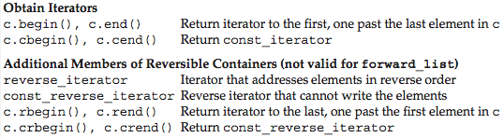
Obtaining Iterators
Notes:
Mention the begin and end wrappers also.

Slide 11

Using Iterators
Remember that end is non-inclusive
it’s “one-past-the-end”
Advance the iterator until it equals end

Slide 12

Assigning from a Different Container Type

Slide 13


swap
Notes:
It swaps implementation – usually pointers.

Slide 14
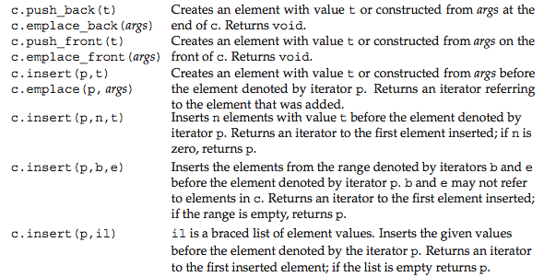
Adding Elements

Slide 15
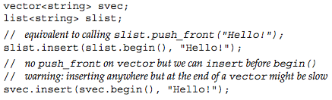

Inserting Elements

Slide 16

Subscripting vs. at
Using operator[ ] is fast
but dangerous!
doesn’t check if you’re out of bounds
at( ) checks
and throws an exception if you goof

Slide 17
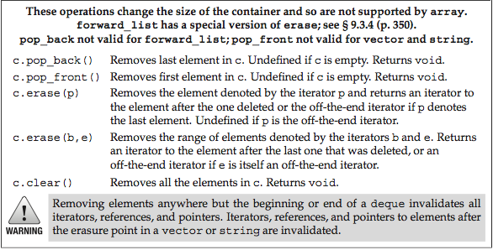
Erasing Elements

Slide 18

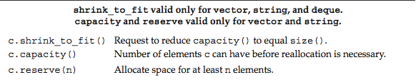
Managing Container Size

Slide 19
container adaptors

Slide 20
Container Adaptors
“Higher-level” Containers
they privately use sequential containers for storage
Have a restricted set of operations
stack
queue
priority_queue

Slide 21

std::stack
Defined in <stack>
Uses a deque for storage by default
Can change: stack<int, vector<int>> stk;

Slide 22
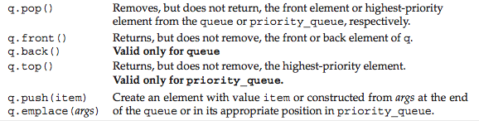
std::queue and std::priority_queue
Defined in <queue>
queue uses a deque by default
priority_queue uses a vector by default
can’t use a list
Notes:
heaps need contiguous storage.

Slide 23
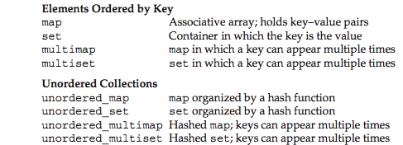
Associative Containers
The ordered containers used tree-based storage
O(log n) retrieval complexity
The unordered containers are hash tables
O(1) retrieval complexity

Slide 24
Ordered Set Example
#include <iostream>
#include <set>
#include <string>
using namespace std;
int main()
{
// Populate a set:
set<string> s;
s.insert("Alabama");
s.insert("Georgia");
s.insert("Tennessee");
s.insert("Tennessee");

Slide 25
// Print it out:
auto p = s.begin();
while (p != s.end())
cout << *p++ << endl;
cout << endl;
// Do some searches:
string key = "Alabama";
p = s.find(key);
cout << (p != s.end() ? "found " : "didn't find ")
<< key << endl;
key = "Michigan";
p = s.find(key);
cout << (p != s.end() ? "found " : "didn't find ")
<< key << endl;
}

Slide 26
// Output:
Alabama
Georgia
Tennessee
found Alabama
didn't find Michigan

Slide 27
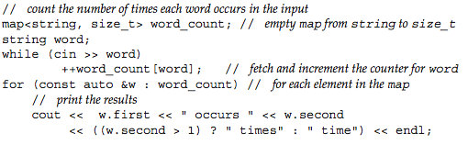

Word Count Program

Slide 28
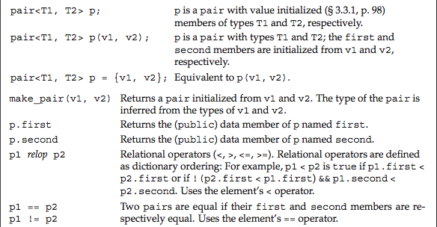
std::pair Operations
Defined in <utility>

Slide 29
Another Map Example
#include <iostream>
#include <map>
#include <string>
using namespace std;
int main()
{
// Insert some elements (three ways):
map<string, string, greater<string>> m;
m.insert(make_pair("Alabama","Montgomery"));
m.insert({"Tennessee","Knoxville"});
m["Georgia"] = "Atlanta";
m["Tennessee"] = "Nashville"; // Overwrites
Notes:
insert doesn’t overwrite.

Slide 30
// Print the map:
for (const auto& elem: m)
cout << '{' << elem.first << ','
<< elem.second << "}\n";
cout << endl;

Slide 31
// Retrieve via a key:
cout << '"' << m["Georgia"] << '"' << endl;
cout << m.size() << endl;
cout << '"' << m["Texas"] << '"' << endl;
cout << m.size() << endl;
}
// Output:
{Tennessee,Nashville}
{Georgia,Atlanta}
{Alabama,Montgomery}
"Atlanta"
3
""
4

Slide 32
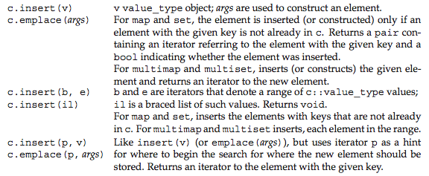
Insert Operations

Slide 33
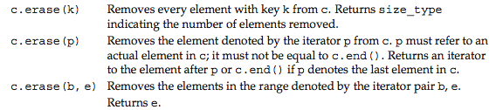
Erase Operations

Slide 34
Strict Partial Orderings A Model of “Less-than”
priority_queue and ordered associative containers (set, map, multi_set, multi_map) require strict partial ordering comparators
AKA “strict weak order” (http://en.wikipedia.org/wiki/Weak_ordering)
behaves like less< >( ) ( (which calls operator<( ))
never use <= or anything like it!!!
Definition: f(x,y) is a SPO if:
f(x,x) = false (irreflexive)
f(x,y) = !f(y,x) (anti-symmetric)
f(x,y) && f(y,z) => f(x,z) (transitive)
Notes:
Just think “less-than” to understand SWOs. It allows ordering and searching with one operation (no need for an equal-to operator).

Slide 35
map and set use SPOs!
Necessary to maintain proper order in the underlying tree data structure
They test for equivalence, not equality, to maintain uniqueness
x and y are equivalent iff !cmp(x,y) && !cmp(y,x)
i.e., neither precedes the other
Example:
swo.cpp
ignores non-alpha characters in strings
Notes:
In swo.cpp, change the < to <= in line 20 and compare the result! The test for equivalence fails!

Slide 36
Another Example
Creates a last/first key type
Defines a strict-partial bool operator( )
See records.cpp
Note: ALL containers require a default constructor of their containees!
Use =default if applicable

Slide 37
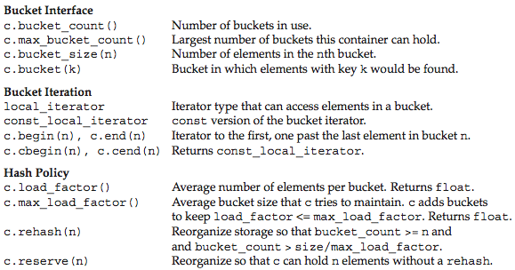
Unordered Container Operations

